Slide 1
Lightning Web Component
Amit Singh

Slide 2
Before We Start
Software Installation
Useful Plugins for VS Code

Slide 3
Software Setup
VS Code
JDK Installation (Zulu)
Salesforce CLI
Salesforce Extension Pack
Important extensions like beautifier, bracket colorizer, etc, LWC Short Keys, LWC Builder

Slide 4
Introduction
Introduction to LWC
Why LWC ( LWC vs AURA )
Your First Web Component

Slide 5
Anatomy of LWC
LWC is a programming model (stacks) that is used to develop the lightning component like Aura.
Lightning web components are custom HTML elements built using HTML and modern JavaScript
It’s a UI framework that is built using native HTML and modern JavaScript.
It uses core web component standards and leverages custom elements, templates, decorators, modules, shadow DOM

Slide 6
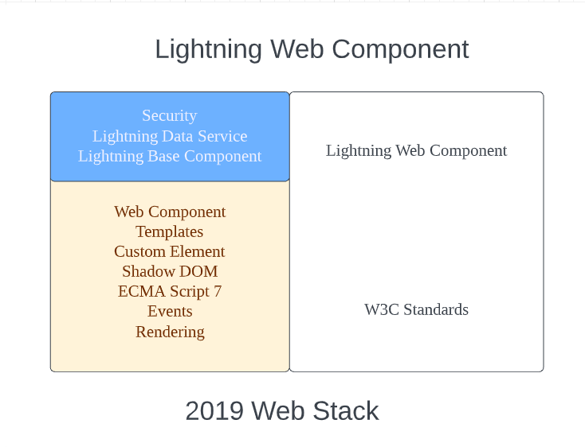
Anatomy of LWC

Slide 7
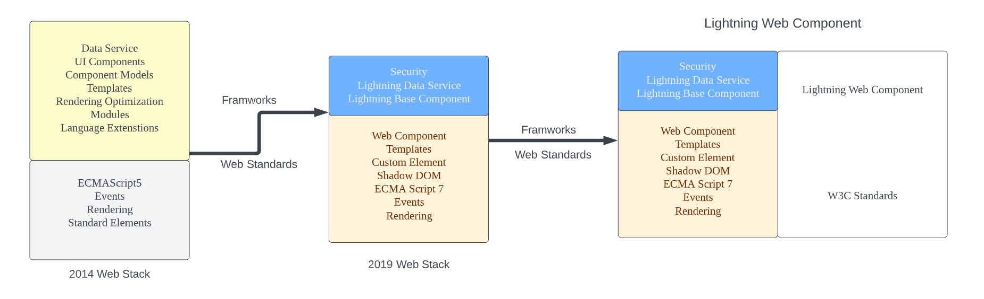
LWC vs Aura
At the same time, many different frameworks came into the picture like Angular, React, and Aura. All these frameworks came with these missing key elements that we needed to create UI components. Like
Shadow DOM
Custom Templates
Custom Elements

Slide 8
LWC is Preferred because?
ECMAScript
ES6 (ECMAScript 2015)
ES7 (ECMAScript 2016)
ES8 (ECMAScript 2017)—excluding Shared Memory and Atomics
ES9 (ECMAScript 2018)—including only Object Spread Properties (not Object Rest Properties)
Classes
Modules
Promises
Decorators
Web Components
Custom Elements
Shadow DOM
Templates and slots

Slide 9
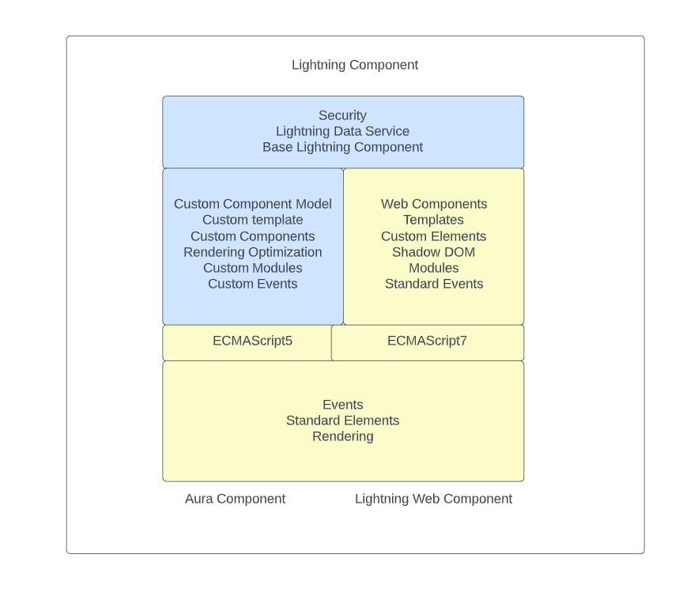

Slide 10
Benefits
With the power of the latest web stack, LWC comes with many different advantages over aura components as follows:
Better performance
Modern web standards
Compatible with Aura components
Faster loading sites
Better security, better testing, and better browser compatibility
Ease of development

Slide 11
First Lightning Web Component
The component name should follow below naming convention rules:
Must begin with a lowercase letter
Must contain only alphanumeric or underscore characters
Must be unique in the namespace
Can’t include whitespace
Can’t end with an underscore
Can’t contain two consecutive underscores
Can’t contain a hyphen (dash)

Slide 12
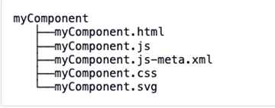
Component Structure

Slide 13
Questions
What are the benefits of the LWC?
Can we use Aura inside LWC?
Can we use LWC Inside AURA?
What is the Top-Most element in LWC?
What are the default files in LWC?
Can we create extra .js file inside LWC component?
Can we create extra .html file inside LWC Component?

Slide 14
Day 2 - Agenda
Decorators in LWC
Properties in Lightning Web Component
Public Property
Private Property
Public Method
Conditional Rendering
Conditional Rendering with Tom & jerry
Iterate through with List
For each
Iterator
Questions

Slide 15
Decorators in LWC
There are mainly 2 types of decorators in LWC @api & @wire
1 - @api – Used to create the public variables/property & public method inside JavaScript class for LWC
2 - @wire – Used to call the Apex Class Methods, Call the modules/methods provided by Lighting Data Service & UI Record API

Slide 16
Properties in Lightning Web Component
In LWC like, like other programming model then are 2 types of properties
Private
Public
You can also create public/private methods inside JavaScript class for LWC

Slide 17
Conditional Rendering
Displaying the component/tag or portion of a component when needed is very important.
In lwc we can use if:true or if:false directive to show/hide the component dynamically

Slide 18
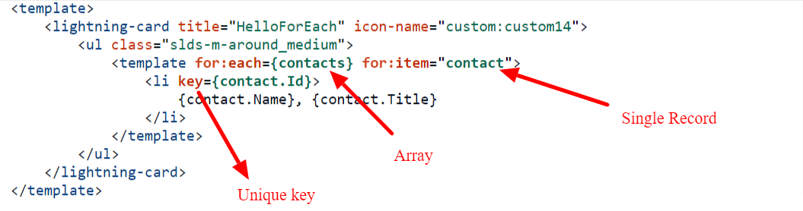
Iterate through with List
For:each When using the for:each directive, use for:item="currentItem" to access the current item. This example doesn’t use it, but to access the current item’s index, use for:index="index". To assign a key to the first element in the nested template, use the key={uniqueId} directive.

Slide 19
Iterate through with List
Iterator
To apply a special behavior to the first or last item in a list, use the iterator directive, iterator:iteratorName={array}. Use the iterator directive on a template tag.
value—The value of the item in the list. Use this property to access the properties of the array. For example, iteratorName.value.propertyName.
index—The index of the item in the list.
first—A boolean value indicating whether this item is the first item in the list.
last—A boolean value indicating whether this item is the last item in the list.

Slide 20
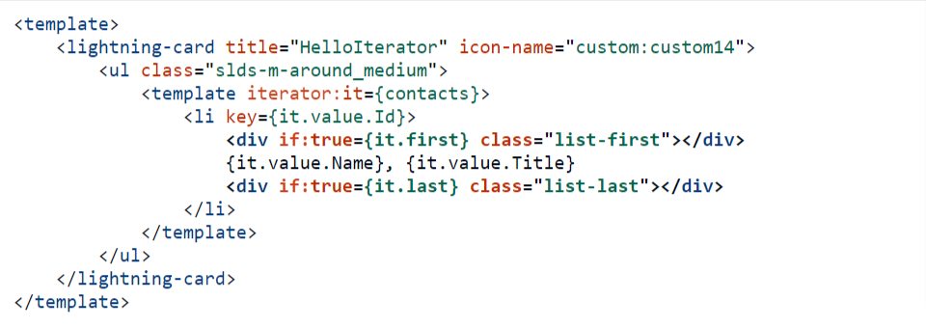
Iterate through with List

Slide 21
Questions
What are the Different Decorators in LWC?
How to create a public method in Lightning Web Component?
What are the different ways to display a list over LWC?
All properties are reactive in LWC?
When should we use Iterator in LWC to render the list?

Slide 22
Day 3 - Agenda
Slots in LWC
Call Client-Side JavaScript From a Button
Call Client-Side JavaScript on Browser Events
Getter Setter in LWC
Component Composition

Slide 23
Slots in LWC
Slot tag is simply a placeholder on the component where a parent component can pass the HTML content i.e. markup.
There are two types of slots:
Unnamed slots - These slots are placeholders on child components that don't have any name associated with them, i.e. if the child has multiple slot tags and parent passes some markup all slots will receive the same markup as there is no identifier to define which markup should go where.
Named slots - When you are passing markup from a parent you define which slot you want to send this markup to by using the slot name.
<slot></slot>
<slot name=“order”></slot>

Slide 24
Call JavaScript Class method
Call Client-Side JavaScript From a Button
Call Client-Side JavaScript on Browser Events
handleChange(event){
}
handleClick(event){
}
handleChange = (event)=> {}

Slide 25
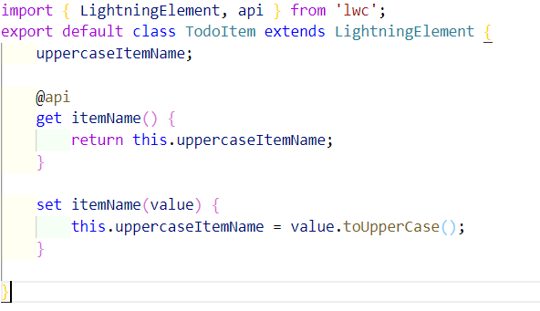
Getter Setter in LWC
To execute a logic every time when a value of a property changes use custom setter method.

Slide 26
Component Composition
Component composition is to create a component hierarchy. For example – Parent/Child/Grand Child
Example – You wanted to display the list of Account Records so you can use a child component to display the account details and use parent component to display the account list

Slide 27
Questions
Can we use setter method without parameter inside it?
What are slots in LWC?
How many level of component composition we can create in LWC?

Slide 28

Assignment
Create a Lightning Web Component with the below inputs
Task Name
Task Priority ( Picklist field with Low, Medium & High Priority )
Create a Custom Button Add to List
When user clicks on “Add To List” the task should be added to the list and all the task should be displayed on the same component

Slide 29
Day 4 - Agenda
Shadow DOM
Events in Lightning Web Component
Call Parent Method from Child Component
Bubble Event
Composed Event
Call Child Method From parent Component

Slide 30
Shadow DOM
The Shadow DOM have three primary effects: DOM access, CSS isolation, and event propagation. LWC components are "first-class" DOM elements.
Events – Events can not cross the Shadow Root by default.
CSS - CSS cannot affect parent, child, or sibling CSS. It is completely isolated, which allows a component to appear as the developer intended regardless of what anyone else might do to that component.
DOM - This should be of no surprise, but you can't use things like document.querySelector to find elements outside of your own Shadow DOM.

Slide 31
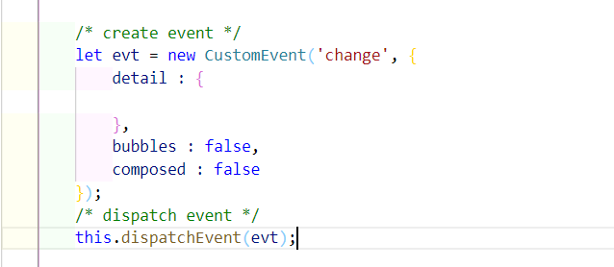
Events
Events in LWC are used to communicate between 2 or more components where child component will fire the event and parent component will handle the event.
Events in Lightning web components are built on DOM Events, a collection of APIs and objects available in every browser.
To create the event in LWC we use CustomEvent interface

Slide 32
Events
Event name best practices:
No uppercase letters
No spaces
Use underscores to separate words
Don’t prefix your event name with the string on, because inline event handler names must start with the string on
Note: - If you pass an object in event detail then any handler can change it without notifying to child component which is bad.

Slide 33
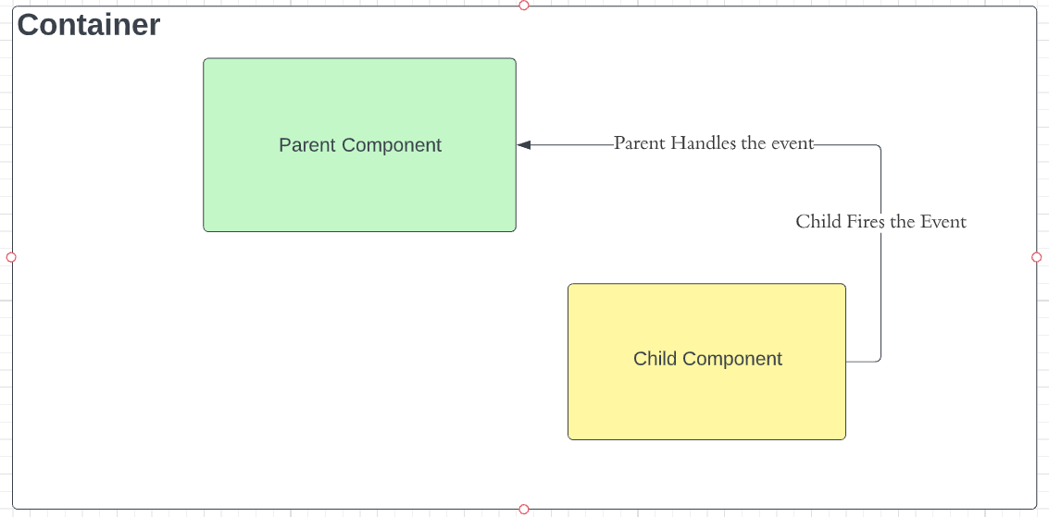

Slide 34
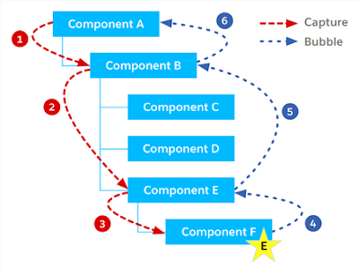
Event Propagation

Slide 35
Event Propagation
Event Propagation:
When an event is fired the event is propagated up to the DOM. Event propagation typically involves two phases event bubbling and event capturing.
bubbles A Boolean value indicating whether the event bubbles up through the DOM or not. Defaults to false.
composed A Boolean value indicating whether the event can pass through the shadow boundary. Defaults to false.

Slide 36
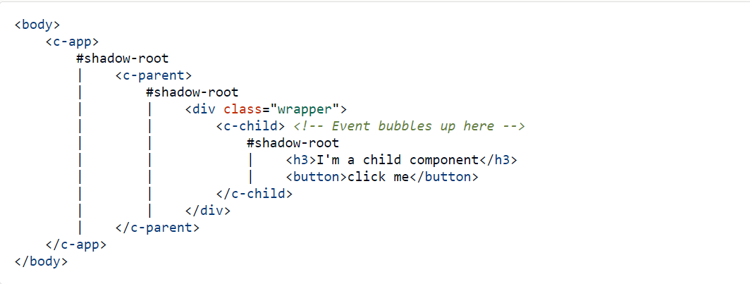
Event Propagation
Let's understand each combination.
Bubbles: false and Composed: false
This is the default configuration in which event is fired, it can be handled only at event listener defined at component as we saw in earlier examples.

Slide 37
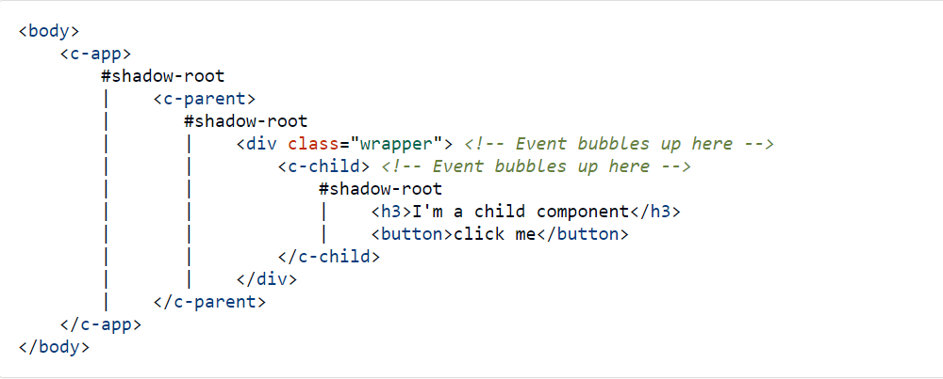
Event Propagation
Bubbles: true and Composed: false
The event bubbles up through the DOM but doesn’t cross the shadow boundary.

Slide 38
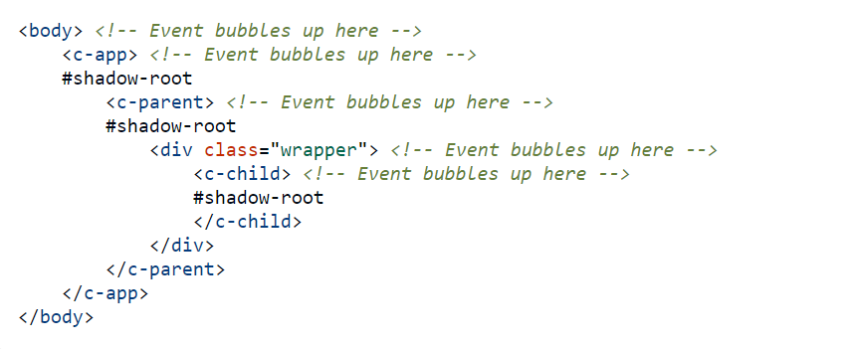
Event Propagation
Bubbles: true and Composed: true
This type of event bubbles up through the DOM and crosses the shadow boundary. This event will bubble up all the way to document root as it can cross shadow boundaries.

Slide 39
Event Propagation
Bubbles: false and Composed: true
This configuration is currently not supported.

Slide 40
Questions
What are the benefits Shadow DOM?
Can we send the event notification from parent to child?
Can we call the child component method from parent component?
What are the different phases of an Event in LWC?
What are the three combination of event phases?
Can we pass object from event as detail property?

Slide 41
Assignment
Use https://gist.github.com/amitastreait/e271ffa3eb5c3f11e6b4a4969d78bf7a JSON and display the list of All Contact Record and Only display Name & Title
Create 1 Lightning Web Component to display the list of Contact Record from the above JSON file
Create another LWC Component which will display the Contact Details
Name
Title
Email
Phone
Picture
Now Create third Component which will have the above 2 component. When user click on Any Contact Record it should fire the event and send back Contact Id.
Find the correct contact record and then Contact Detail Component will display the contact information

Slide 42
Agenda
Configuration File in LWC ( Meta File )
Record Page
Home Page
App Page
TAB
Community
Flow
Inbox
Quick Action

Slide 43
Configuration File in LWC
Meta.xml file is used to expose the LWC to various places inside Salesforce. For Example, Record Page, Home Page, App Page. Community, Chat, Email, Tab. Utility Bar, Quick Action, Flow & etc

Slide 44
Configuration File in LWC
<?xml version="1.0" encoding="UTF-8"?>
<LightningComponentBundle xmlns="http://soap.sforce.com/2006/04/metadata">
<apiVersion>54.0</apiVersion>
<isExposed>false</isExposed>
</LightningComponentBundle>

Slide 45
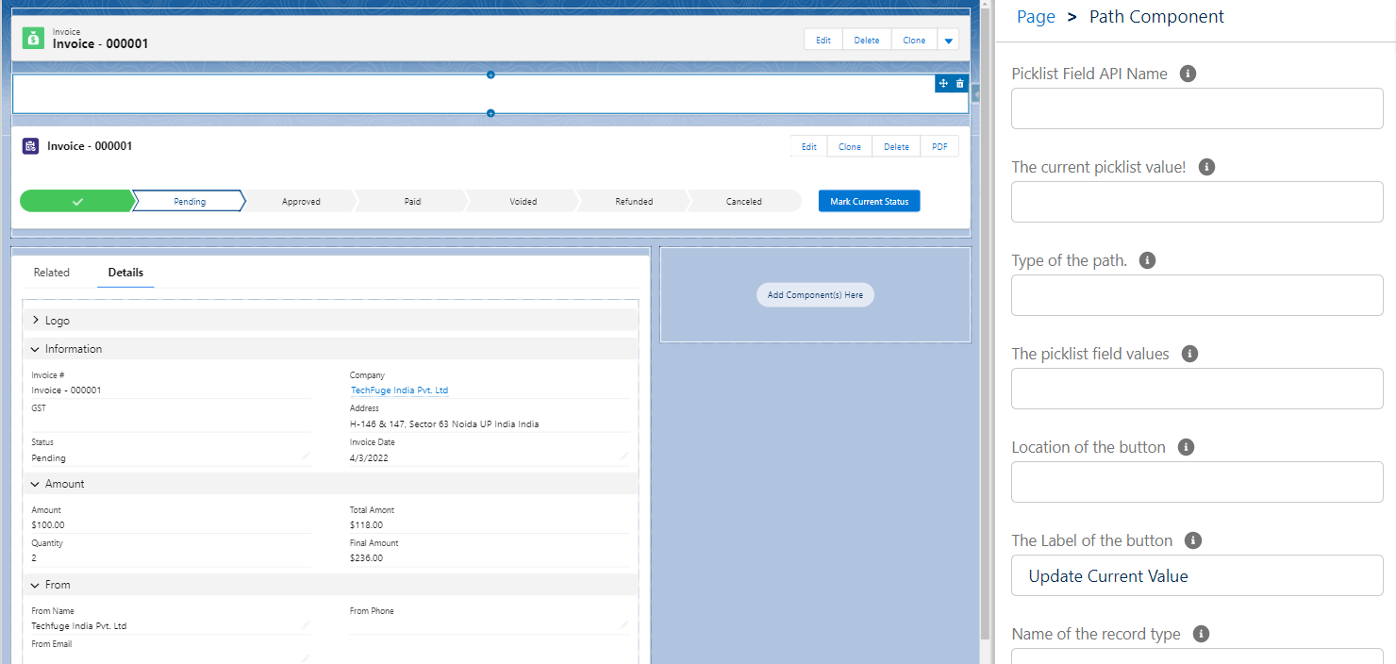

Slide 46
Use LWC Inside VF Page
Use Cases
You wanted to use the same component in Lightning and Classic
You wanted to use the Lightning Web Component inside the Force.com site or Portals
You wanted to use your LWC component outside of the salesforce

Slide 47
Steps
Create a Lightning Web Component
Create Aura Application
Create a VF Page

Slide 48
Create Aura Application
<aura:application extends="ltng:outApp" >
<c:helloWorldComponent></c:helloWorldComponent>
</aura:application>

Slide 49
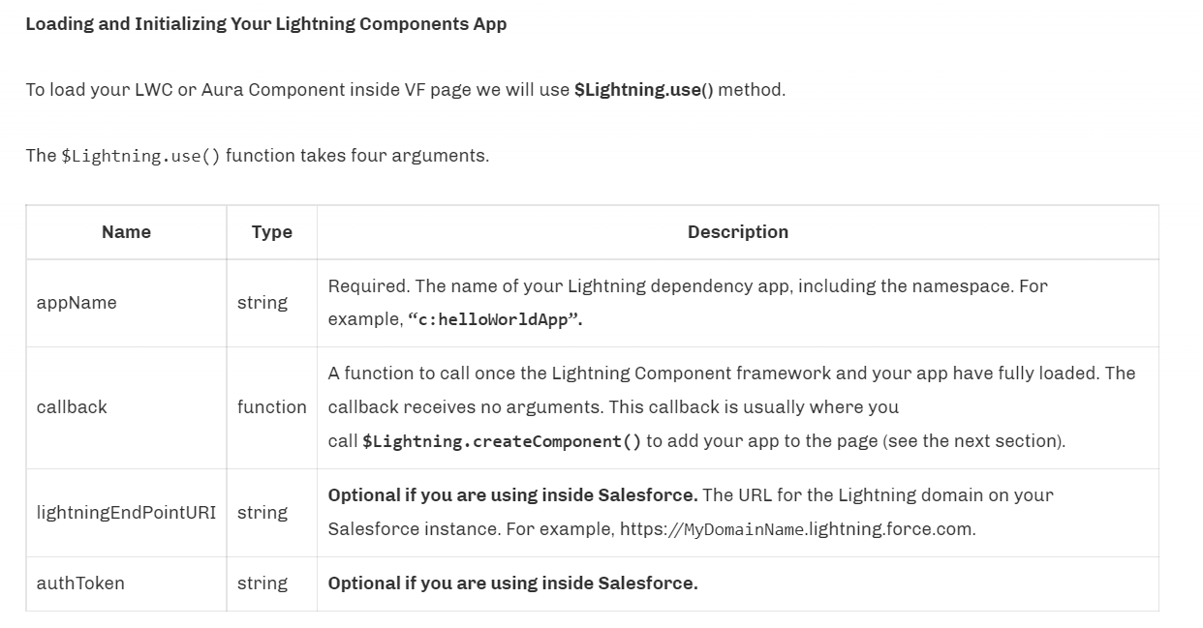
Create a VF Page

Slide 50
<apex:page showHeader="false" sidebar="false">
<apex:includeLightning />
<div id="LightningComponentid" />
<!-- the Id of div tag which will be used to render your LWC component -->
<script>
$Lightning.use("c:helloWorldApp", function() {
$Lightning.createComponent("c:helloWorldComponent",
{
message : 'Simple Message From VF Page', // You can pass the value to @api attributes if you have inside JavaScript Class.
recordId : '001HJJu34iun34jn'
},
"LightningComponentid", // the Id of div tag where your component will be rendered
function(cmp) {
console.log('Calling the LWC Component');
});
});
</script>
</apex:page>

Slide 51
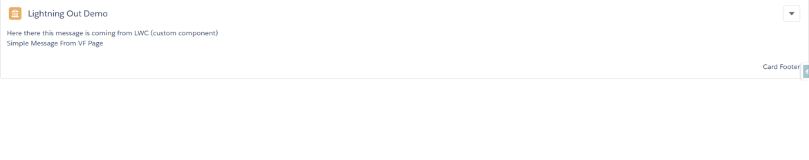

Slide 52
Agenda
Lightning Data Service
Record Form
Record View Form
Record Edit Form
UI Record API
Create Record
Get Record

Slide 53
Lightning Data Service
Lightning Data Service manages data for you; changes to a record are reflected in all the technologies built on it. Contrastingly, data from Apex is not managed; you must refresh the data.
In a Lightning web component, perform operations on data and access metadata using these technologies built on Lightning Data Service:
Components—lightning-record-edit-form, lightning-record-form, and lightning-record-view-form
Wire adapters and functions in the lightning/ui*Api modules

Slide 54
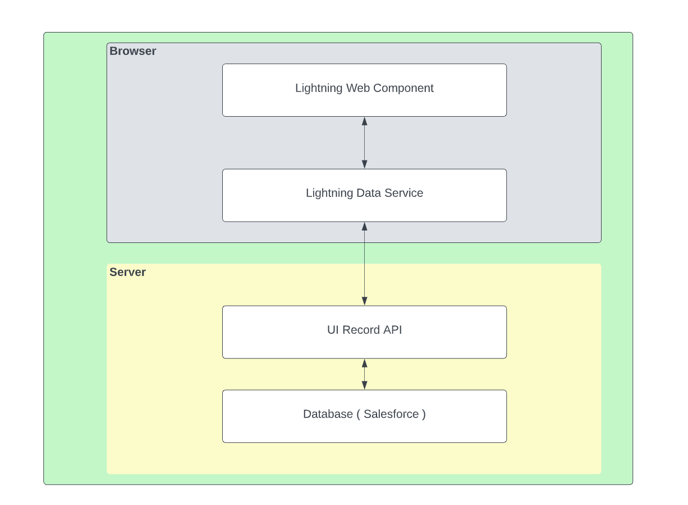
Lightning Data Service

Slide 55
Work with Data using Base Components
lightning-record-edit-form—Displays an editable form.
lightning-record-view-form—Displays a read-only form.
lightning-record-form—Supports edit, view, and read-only modes

Slide 56
Agenda - UI Record API
Create Record
Get Record
Update Record
Delete Record

Slide 57
UIRecord API
lightning/uiRecordApi module includes wire adapters to record data and get default values to create records. It also includes JavaScript APIs to create, delete, update, and refresh records.
createRecord(recordInput)
deleteRecord(recordId)
getRecord
getFieldValue(record, field)
updateRecord(recordInput, clientOptions)

Slide 58
Wire in Salesforce
The wire service provisions an immutable stream of data to the component. Each value in the stream is a newer version of the value that precedes it.
Wire method always returns read only data. If you want to make changes the make a shallow copy and then make the changes
import { adapterId } from 'adapterModule';
@wire(adapterId, adapterConfig)
propertyOrFunction;
The object supplied to the has this shape.
data (Any type)—The value supplied by the adapter.
error (Error)—An error if the adapter wasn’t able to supply the requested data or if the adapter wasn’t found. Otherwise, this property is undefined.

Slide 59
createRecord(recordInput)
This method creates a record with the provided input for the specific object.
Syntax
import { createRecord } from 'lightning/uiRecordApi';
createRecord(recordInput: Record): Promise<Record>
const fields = {};
fields[NAME_FIELD.fieldApiName] = this.name;
const recordInput = { apiName: ACCOUNT_OBJECT.objectApiName, fields };

Slide 60
getRecord
import { LightningElement, wire } from 'lwc';
import { getRecord } from 'lightning/uiRecordApi';
@wire(getRecord, { recordId: string, fields: string|string[], optionalFields?: string|string[] })
propertyOrFunction
@wire(getRecord, { recordId: string, layoutTypes: string|string[],
modes?: string|string[], optionalFields?: string|string[] })
propertyOrFunction
getFieldValue(this.account.data, PHONE_FIELD)

Slide 61
updateRecord(recordInput, clientOptions)
Updates a record. Provide the record Id of the record to update in recordInput.
Syntax
import { updateRecord } from 'lightning/uiRecordApi';
updateRecord(recordInput: Record, clientOptions?: Object): Promise<Record>
const fields = {};
fields[ID_FIELD.fieldApiName] = this.contactId;
fields[FIRSTNAME_FIELD.fieldApiName] = ‘’
fields[LASTNAME_FIELD.fieldApiName] = ‘’
clientOptions = {'ifUnmodifiedSince' : lastModifiedDate}

Slide 62
deleteRecord(recordId)
import { deleteRecord } from 'lightning/uiRecordApi';
deleteRecord(recordId: string): Promise<void>

Slide 63
Assignment
Create a LWC to take the input from the User to create Contact & Account from the same Component.
Contact must be associated to Account Record!
Account
Name
Contact
FirstName
LastName
Email
Phone
Create Records –
Create an Account get the AccountId & Then Create the Contact under the Same Contact

Slide 64
Agenda
Object Info API
Object Information
Picklist Information
Picklist Based on Record Type

Slide 65
Object Info API
Use this wire adapter to get metadata about a specific object. The response includes metadata describing the object’s fields, child relationships, record type, and theme.
import { LightningElement, wire } from 'lwc';
import { getObjectInfo } from 'lightning/uiObjectInfoApi';
import ACCOUNT_OBJECT from '@salesforce/schema/Account';
export default class Example extends LightningElement {
@wire(getObjectInfo, { objectApiName: ACCOUNT_OBJECT })
propertyOrFunction;
}

Slide 66
getPicklistValuesByRecordType
Use this wire adapter to get the values for every picklist of a specified record type.
import { LightningElement, wire } from 'lwc';
import { getPicklistValuesByRecordType } from 'lightning/uiObjectInfoApi';
import ACCOUNT_OBJECT from '@salesforce/schema/Account';
export default class Example extends LightningElement {
@wire(getPicklistValuesByRecordType, { objectApiName: ACCOUNT_OBJECT, recordTypeId: '012000000000000AAA' })
propertyOrFunction
}

Slide 67
Questions
What is Lighting Data Service?
What are benefits if LDS?
Can we use Dynamic Fields in LDS?

Slide 68
Assignment
Create a Lightning Web Component which will
Fetch the Account Information
Fetch the Account Industry Information
Create a Lightning Combo box to display Account Industry, Create input fields to take input for account name and phone.
Have a button to create account record and it should create account for the selected industry

Slide 69
Agenda
Call Apex using @wire
Error handling in @wire methods
Call Apex using the imperative method

Slide 70
@wire adaptor in Salesforce
To read Salesforce data, Lightning web components use a reactive wire service.
To use @wire to call an Apex method, annotate the Apex method with @AuraEnabled(cacheable=true)
A client-side Lightning Data Service cache is checked before issuing the network call to invoke the Apex method on the server.
To refresh stale data, call refreshApex(), because Lightning Data Service doesn’t manage data provisioned by Apex.
The data returned by @wire is readonly that means we can not modify the data. If you want make a shallow copy and then modify it.

Slide 71
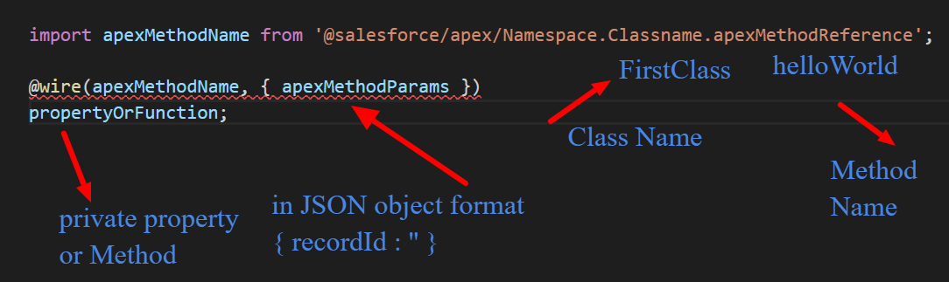
JS Syntax to Call Apex Method

Slide 72
Imperative Apex
To control when the method invocation occurs (for example, in response to clicking a button), call the method imperatively. When you call a method imperatively, you receive only a single response
In the following scenarios, you must call an Apex method imperatively as opposed to using @wire.
To call a method that isn’t annotated with cacheable=true, which includes any method that inserts, updates, or deletes data.
To control when the invocation occurs.
To work with objects that aren’t supported by User Interface API, like Task and Event

Slide 73
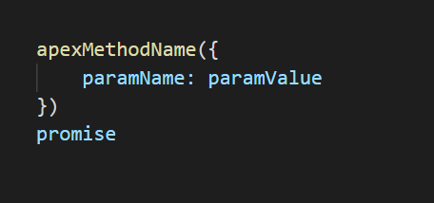
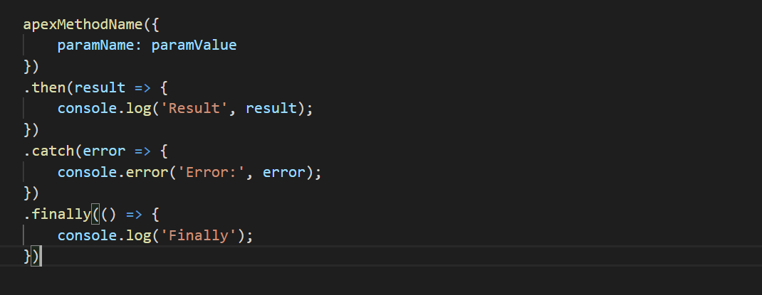
JS Syntax for Imperative Apex

Slide 74
Questions
What are the requirement to make the apex call from LWC?
What are the minimum requirement to make a @wire call?
Can we call a @wire method with button click?
Can we mutate the data returned by @wire method by default
Can we perform the DML from the apex method which is called from @wire adaptor?

Slide 75
Assignments
Create a LWC which will call the apex class method using @wire method that will return the list of top 10 accounts and do console.log for the data. Display the list of accounts in LWC. Name the component as wireAccountList
Account Name, Industry, Phone & Rating
Create a LWC which will call the apex class method using @wire method but make sure that the method will be called from a button click that will return the list of top 10 accounts and do console.log for the data. Display the list of accounts in LWC. Use the same component as assignment 1
Account Name, Industry, Phone & Rating
Create a LWC Component to display the input to create Account Record and have a button. On the Button click call a method, that method should create the account in Salesforce. Name the component as wireCreateAccount
Name, Phone

Slide 76
Assignments
Create a LWC which will call the apex class method using @wire method that will return the list of top 10 accounts and do console.log for the data. On the Left half of the component. Display the list of accounts in LWC. Name the component as wireAccountList
Display Following Fields
Account Name, Industry, Phone & Rating
When clicking on any Account Record it should display the details about the clicked account on the right half. With following fields
Account Name – Bold
Phone, Type, No of Employees, Industry, Website & Address
Note – You need to apply the concept of events here. Create Three Component
wireAccountList – Should call the apex class and have the list of account.
wireAccountTile – Should accept account using public property and display the account information Account Name, Industry, Phone & Rating
wireAccountInformation – Should Accept selected account using public property and display the complete account information.
Hint - #2 & #3 component will be called from #1 Component

Slide 77
Agenda
LifeCycle Hook Methods in LWC

Slide 78
Callbacks in LWC
Constructor
connectedCallback
renderedCallback
disconnectedCallback
errorCallback
render

Slide 79
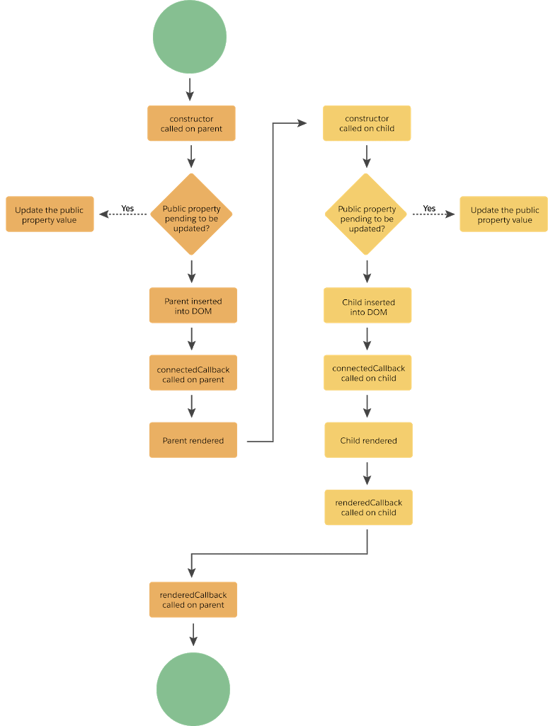

Slide 80
constructor in LWC
It fires when the component is created.
This flows in lwc from parent to child.
First statement must be super() with no parameters.
At that point, component properties won’t ready yet.

Slide 81
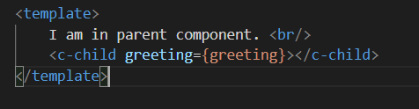

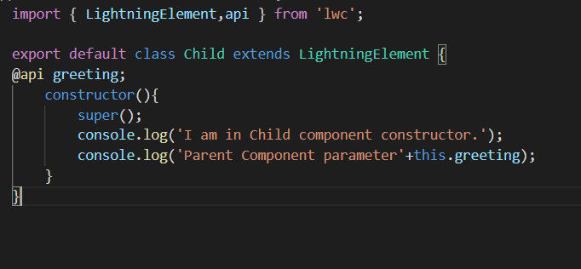
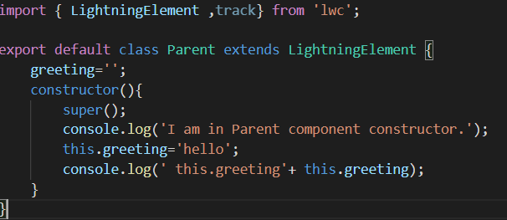
Example of Constructor

Slide 82
DO’S & DON’T
DO’S
Use navigation services. Note: services like show toast message is not valid because it uses dispatchEvent and it is not allowed in the constructor.
Set the value of properties and also can define the variable.
Call an apex method.
Call UI APIs like uiRecordApi.
DON’T
Don’t try to access the element’s attributes because they don’t exist yet.
Cannot create and dispatch custom events from the constructor.
Cannot manipulate the DOM.

Slide 83
connectedCallback in lWC
We use it when we want to do something after component is loaded.
This flows in lwc from parent to child.
You can’t access child elements from the callbacks because they don’t exist yet.

Slide 84
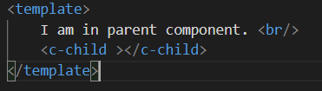
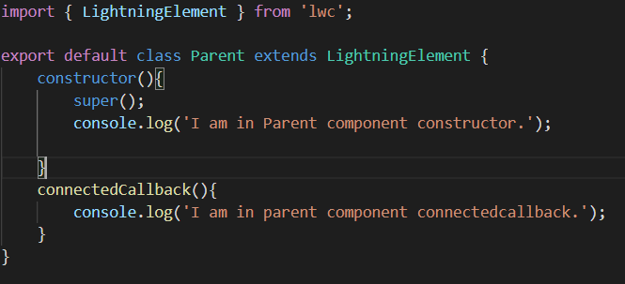
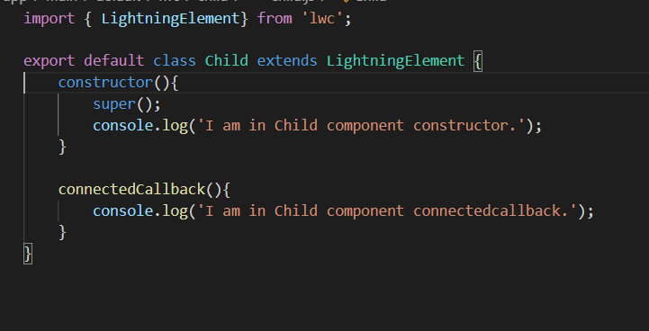
Example of Connectedcallback

Slide 85
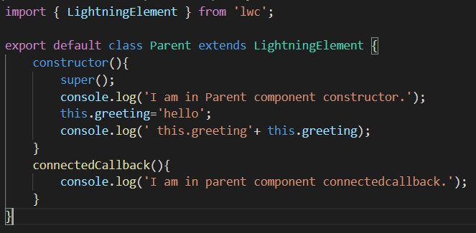
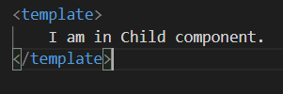
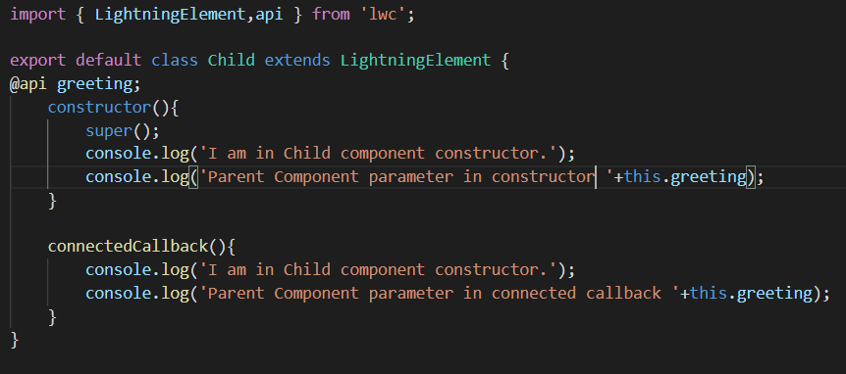
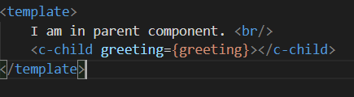

Slide 86
DO’S & DON’T
DO’S
Fire a custom event.
Call UI APIs & use navigation service.
Subscribe and Unsubscribe from a Message Channel.
Access the elements of the component. Note that we do not have access to any child component’s elements as till now they are not in existence.
DON’T
Cannot access the elements of the child component because they don’t exist yet.

Slide 87
disconnectedCallback in LWC
It fires when component is removed from the element.
It fire from parent to child.
It is used to clean up the work done in connected callback.

Slide 88
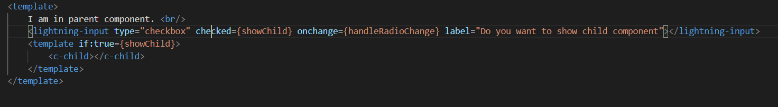
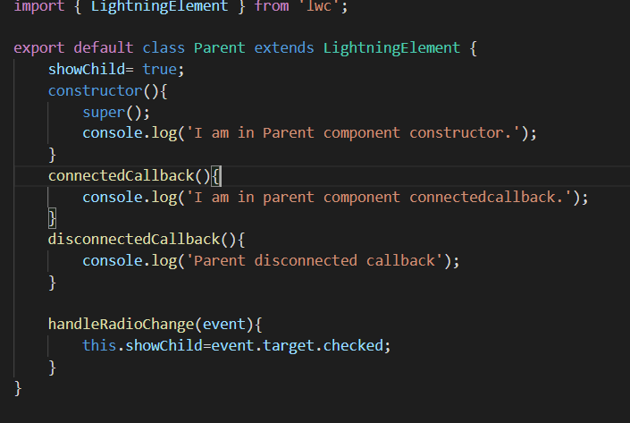
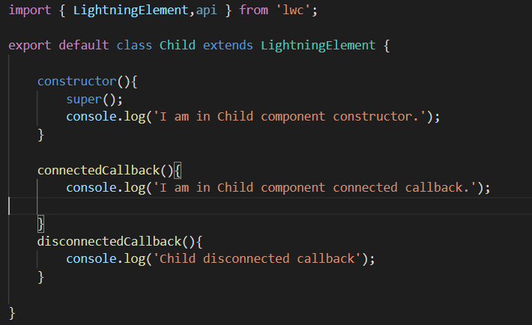
Example of Disconnected callback

Slide 89
DO’S
DO’S
Remove the caches.
Remove the event listeners.
Unsubscribe LMS channels.

Slide 90
renderedCallback in LWC
Fire when component rendering is done.
It can fire more than once.
It flow from child to parent.

Slide 91
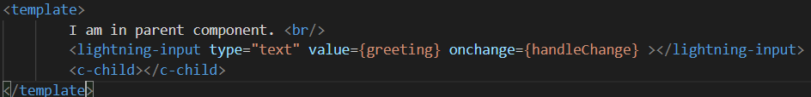
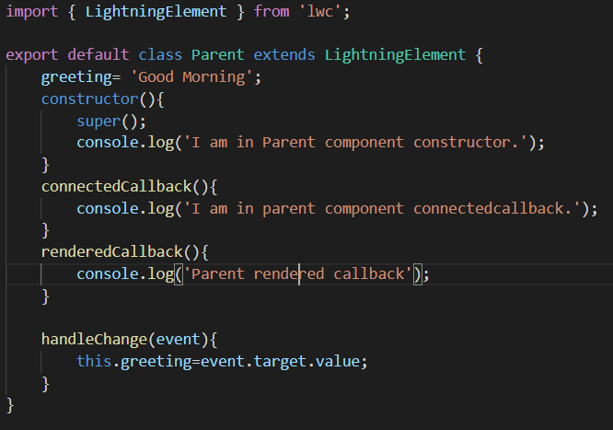
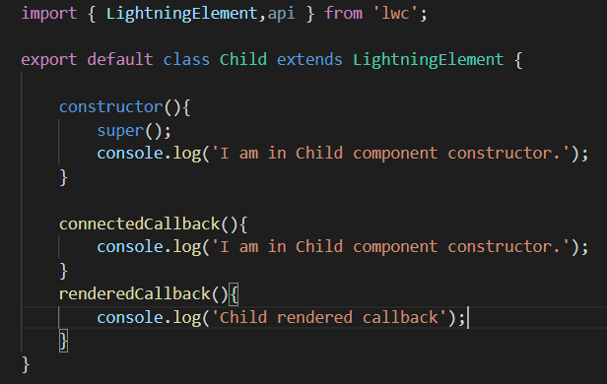
Example of Rendered callback

Slide 92
DO’S & DON’T
DO’S
Perform business logic after a component has finished the rendering phase.
Access the elements of the component.
Call an Apex method.
Create and Dispatch custom events.
Call UI APIs with show toast events.
Call navigation services.
DON’T
Don’t use renderedCallback() to change the state of a component that is setting properties value, always use getter and setter.
Can’t update a wire adapter configuration object property in renderedCallback(), as it can result in an infinite loop.
Don’t update a reactive property or field in renderedCallback(), as it can result in an infinite loop.

Slide 93
Render in LWC
Call this method to update the interface.
It may be called before or after the connected callback.
It is used to conditionally render the template.

Slide 94
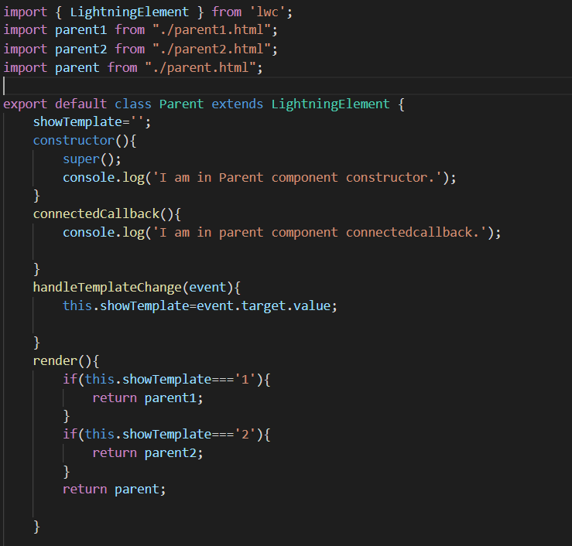
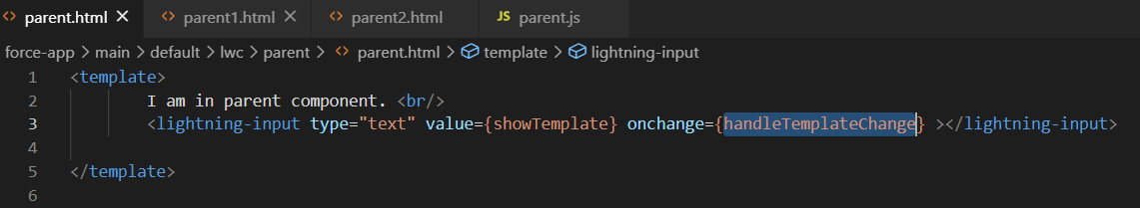
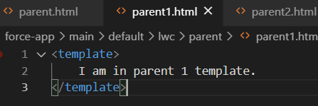
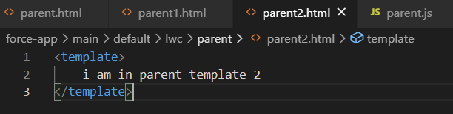
Example of render

Slide 95
errorCallback IN LWC
Capture errors that happen in all the child components life cycle hooks.
It has two parameters i.e. error and stack.
This method works like a JavaScript catch() block for catching the error.

Slide 96
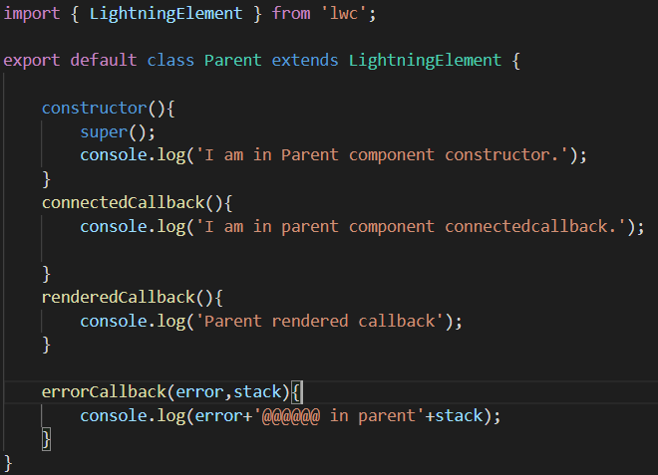
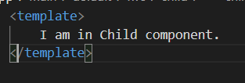
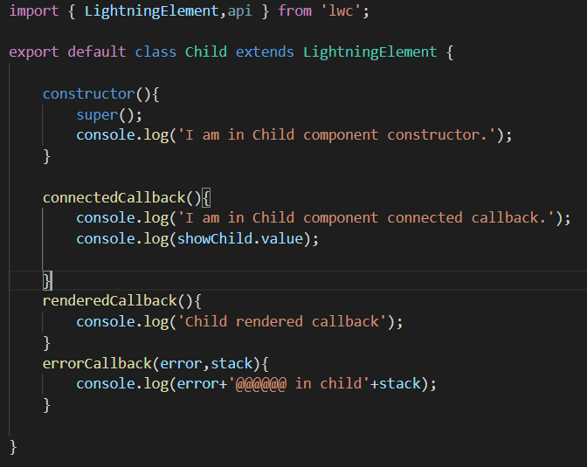
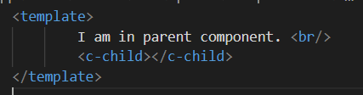

Slide 97
Agenda
Use External Library in LWC

Slide 98
Use External Library in LWC
You can use third-party JavaScript libraries with Lightning web components. For example, use a library with interactive charts and graphs or a library that reduces code complexity.
Download the library from the third-party library's site.
Upload the library to your Salesforce organization as a static resource.
import resourceName from '@salesforce/resourceUrl/resourceName';
import { loadStyle, loadScript } from 'lightning/platformResourceLoader';
import myLib from '@salesforce/resourceUrl/myLib';
Load the library and call its functions in a then() method
loadScript(this, myLib + '/myLib.js').then(() => {
let result = myLib.myFunction(2,2);
});

Slide 99
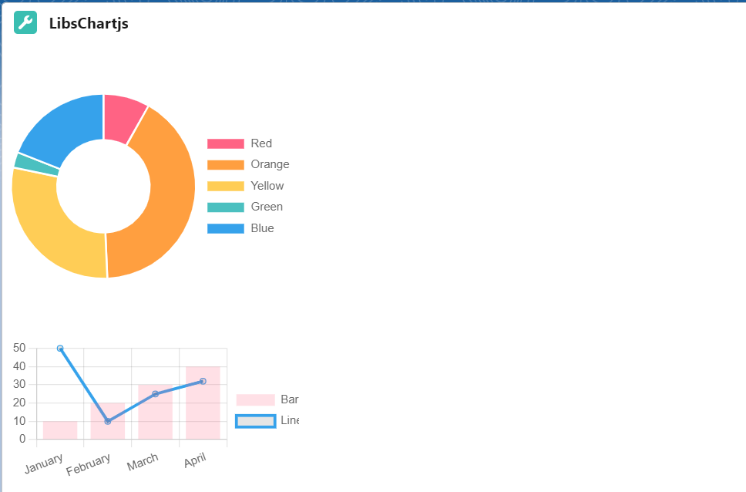
Use External Library in LWC
https://www.chartjs.org/docs/latest/
Full Calendar v4 - https://fullcalendar.io/docs/v4/getting-started

Slide 100
Assignment
Create Google Calendar to display the Events from Salesforce as well as from Google Calendar as well.
Here is the reference Link for the same - events from Google Calendar
Also, implement the event click for date & event. When User clicks on Date then open a new popup to add the Event for the same date.
If user clicks on the event and the event is of type Salesforce Event Open the Popup to display the event details.

Slide 101
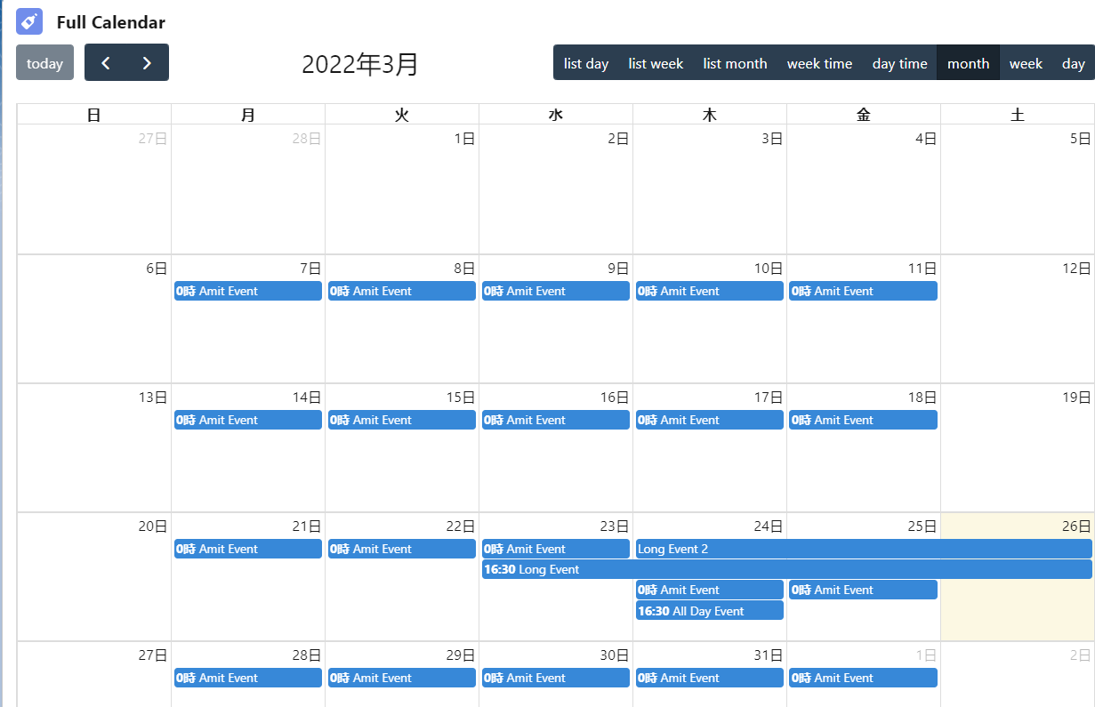
Assignment

Slide 102
Agenda
Use Custom label in LWC
How to use reusable CSS in LWC
Toast Event in LWC

Slide 103
Use Custom label in LWC
Custom labels are text values stored in Salesforce that can be translated into any language that Salesforce supports.
Use custom labels to create multilingual applications that present information (for example, help text or error messages) in a user’s native language.
import labelName from '@salesforce/label/labelReference';

Slide 104
Share CSS
/* Syntax */
@import 'namespace/moduleName';
/* Example */
@import 'c/cssLibrary';

Slide 105
Toast Event in LWC
Display toasts to provide feedback to a user following an action, such as after a record is created.
To trigger a toast from a Lightning web component, in the component's JavaScript class, import ShowToastEvent from lightning/platformShowToastEvent. Create a ShowToastEvent with a few parameters, and dispatch it.

Slide 106
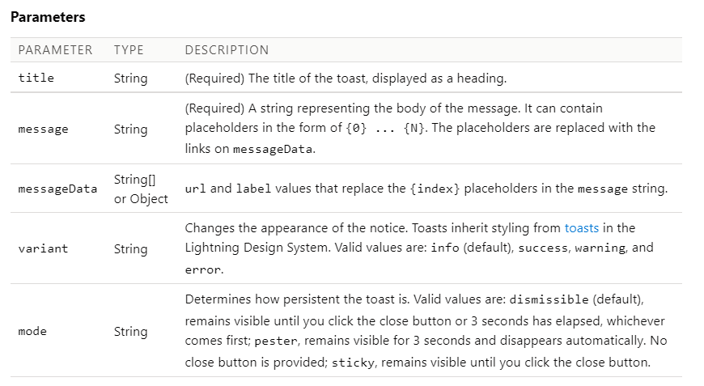

Slide 107
Simple Toast
const event = new ShowToastEvent({
title: 'Get Help',
message:
'Salesforce documentation is available in the app. Click ? in the upper-right corner.',
});
this.dispatchEvent(event);

Slide 108
Display Link with Toast
const event = new ShowToastEvent({
title: 'Success!',
message: 'Record {0} created! See it {1}!',
messageData: [
'Salesforce',
{
url,
label: 'here',
},
],
});
this.dispatchEvent(event);

Slide 109
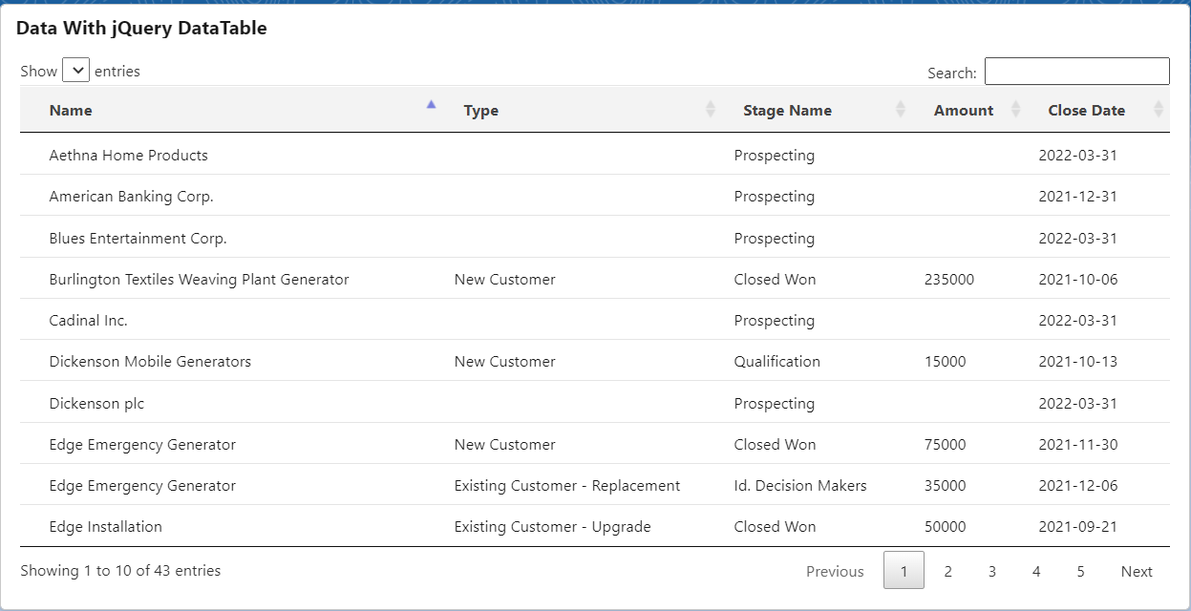
Assignment
Create a Lighting Web Component which will display all the opportunities using Jquery DataTable

Slide 110
Agenda
Reuse javascript

Slide 111
Agenda
Page Reference in LWC

Slide 112
Agenda
Lightning Message Service

Slide 113
Agenda
Work with Lighting Data Table in LWC

Slide 114
Agenda
Lookup Component

Slide 115
Agenda
Picklist Component

Slide 116
Agenda
Testing Lightning Web Component

Slide 117
Agenda
LWC Local Development

Slide 118
Project

